Slide 1



Quick Response Team
One Community’s Response
To The Heroin/Opiate Epidemic
Colerain Township Department of Public Safety
Hamilton County, Ohio

Slide 2
Objectives
Discuss the Quick Response Team (QRT) response model
Describe the need for culture change amongst fire, EMS, and law enforcement personnel.
Review the effectiveness of the QRT response model.

Slide 3
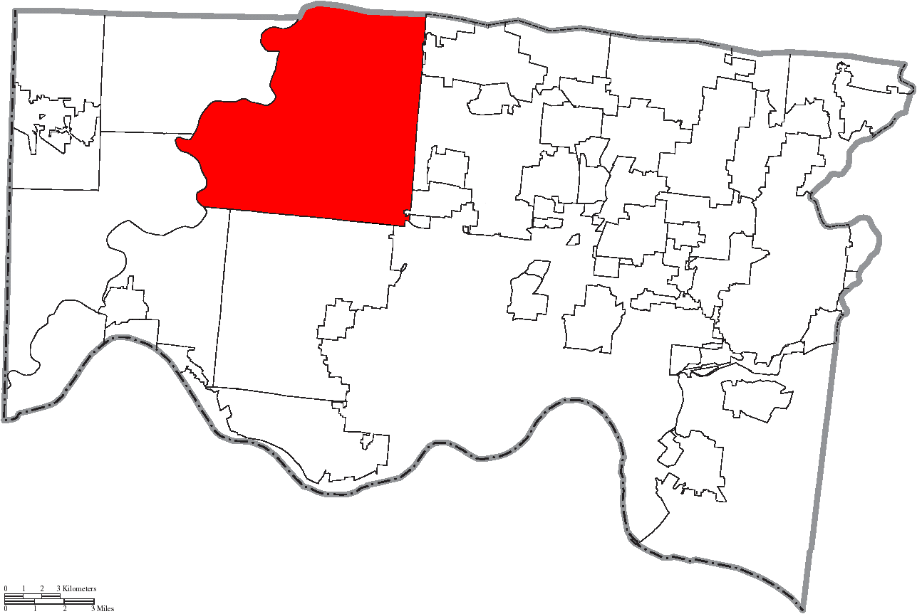
Statistical Data: Painting the Picture
14th Largest Community in the State of Ohio
45 Square Miles
60,000 residents
5 Fire Stations
170 Fire Department Personnel
Fire Department Staffing: 33 personnel
54 Law Enforcement Personnel

Slide 4
QRT Staffing Model
Six firefighter (FF)/medics; each specially trained as a “Tactical Medic” (TACMED) (SWAT, Military and HRT Experience)
Five Police Officers (SWAT, Military, Narcotics Inv. Experience)
Social Worker/Addiction Counseling Expert
Triage
Assessment
Medicaid Sign up Assistance

Slide 5
How Does it Work?
Follow-up is led by police officers and is facilitated by a commitment to investigate the overdose incidents as criminal acts
The police officer brings a paramedic and licensed counselor from the Addiction Services Council of Greater Cincinnati
Discretion is used as a means to introducing the counselor

Slide 6
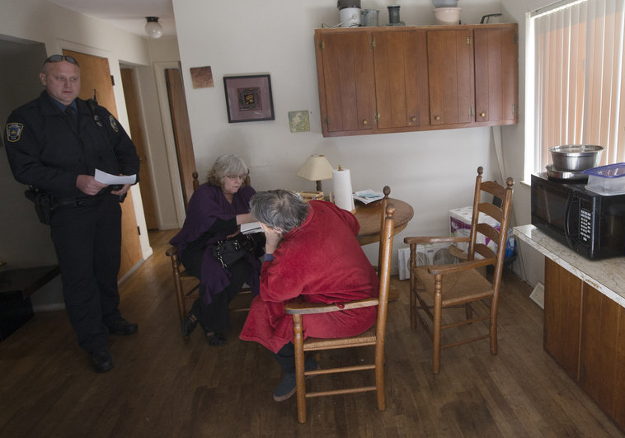
QRT Goal
Move patient towards action
Assist in preparation
“Bridge to treatment”

Slide 7
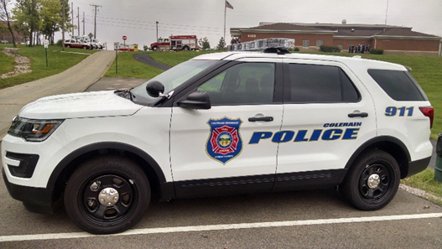
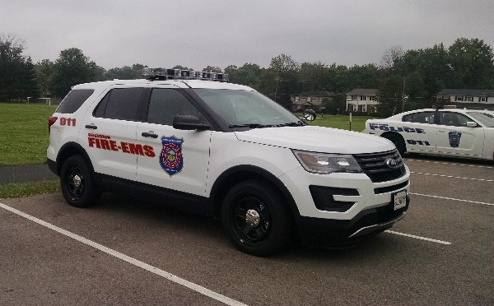

Slide 8
Operational Data
QRT Unit (General Response Model) Operational since July 2015
310 “Overdose Follow-up” investigations (July 2015 through March 2017)
QRT responded to more than 1,500 incidents, to include medic and fire incidents (Experienced “response time” impact)

Slide 9
Overdose Follow-Up Data
The QRT and Addiction Services Council professionals conducted 310 investigations between July 2015 and March 2017. 82% of the persons have entered treatment – in/outpatient
Face to Face Engagement – 250
In recovery - 205
Conducted “door to door” canvassing of “Working to Save Lives” brochure in Township neighborhoods (follow-ups responded to the Police Department, seeking help)

Slide 10
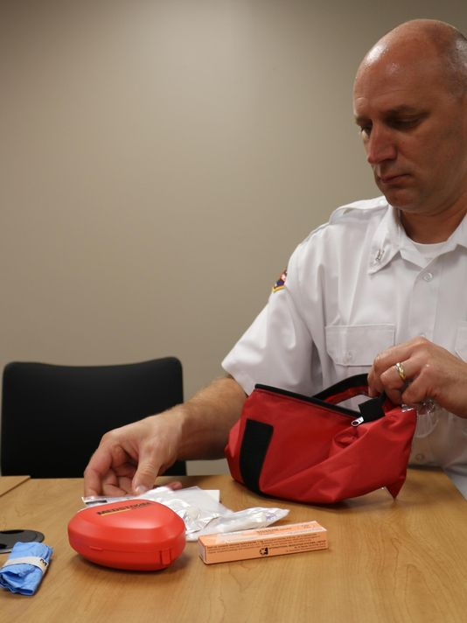
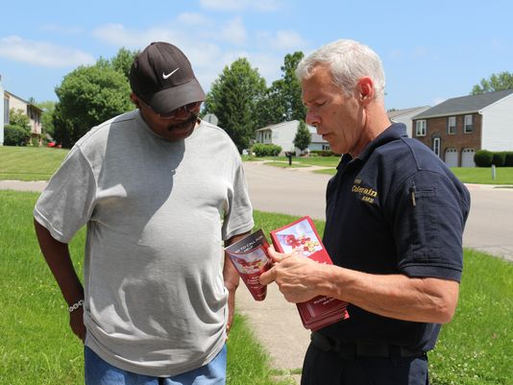
Creating the 360 Solution
Police officers carrying Nasal Narcan
Canvassed “door to door” (Brochure distribution)

Slide 11
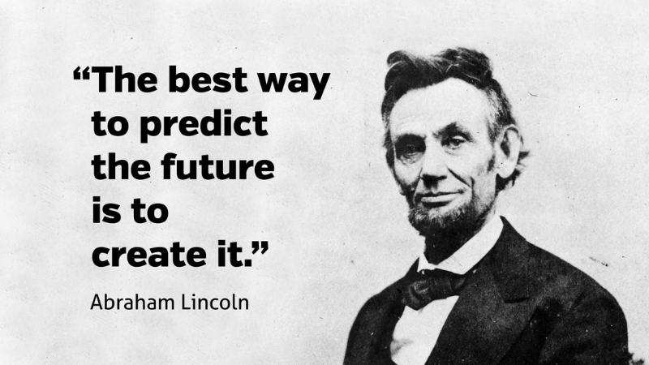
Moving Forward
What are next steps?

